Slide 1
MSc AI for marketing strategy
Customer Relationship Management
Session #4 : Marketing & CRM
Robert Fonteijn

Slide 2

Agenda for this S4
An interesting question
What do you remember of last time?
Positioning exercise
Preparation work for today
Input
Work for next time

Slide 3


How can foundation models and generative AI be used across the fashion value chain ?
https://www.mckinsey.com/Industries/Retail/Our-Insights/Generative-AI-Unlocking-the-future-of-fashion

Slide 4

Generative AI
Generative artificial intelligence (AI) describes algorithms (such as ChatGPT) that can be used to create new content, including audio, code, images, text, simulations, and videos.
Recent new breakthroughs in the field have the potential to drastically change the way we approach content creation.

Slide 5
Merchandising and product
Convert sketches, mood boards, and descriptions into high-fidelity designs (for example, 3-D models of furniture and jewelry).
Enrich product ideation by collaborating with AI agents that generate creative options (for example, new ideas, variations) from data (for example, past product lines, inspirational imagery and style).
Customise products for individual consumers at scale (for example, eyeglasses based on facial topography).

Slide 6
Supply chain and logistics
Support negotiations with suppliers by compiling research.
Augment robotic automation for warehouse operations and inventory management through real-time analytics (for example, insights enabled by augmented reality, or AR).
Tailor product return offers based on individual consumers.

Slide 7
Marketing
Identify and predict trends to improve targeted marketing from unstructured data (for example, consumer sentiment, in-store consumer behavior, omnichannel data).
Automate consumer segmentation at scale to tailor marketing initiatives.
Generate personalized marketing content based on unstructured data from consumer profiles and community insights.
Collaborate with AI agents to accelerate content development and reduce creative blocks for in-house marketing teams.

Slide 8
Digital commerce and consumer experience
Structure and generate sales descriptions based on past successful sales posts.
Personalize online consumer journey and offers (for example, web pages, product descriptions) based on individual consumer profiles.
Tailor virtual product try-on and demos to individual consumers (for example, clothing try-on, styling recommendations).
Enhance intelligent AI agents (for example, conversational chatbots, virtual assistants) and self-service to address advanced consumer inquiries (for example, multilingual support).

Slide 9
Store operations:
Optimise store layout planning by generating and testing layout plans under different parameters (for example, foot traffic, local consumer audience, size).
Optimise in-store labor to avoid bottlenecks such as gaps in staff allocation and theft detection through real-time monitoring of video data.
Support AR-assisted devices to better inform workforce in real time on product (for example, condition, assortment, inventory, recommendations).

Slide 10
Organization and support functions
Coach sales associates to sustain successful “clienteling” relationships via real-time recommendations, feedback reports, and high-value consumer profiles.
Develop individualized training content for employees based on role and performance.
Enable self-serve and automate support tasks (for example, HR tickets, accounting for large documents, review of legal documents).

Slide 11
Agenda for this S4
An interesting question
What do you remember of last time?
Positioning exercise
Preparation work for today
Input
Work for next time

Slide 12
Reminder - the journey
We asked:
What are the data points connected to each step of the journey?
Awareness - discover
Consideration - evaluate
Decision - buy
Experience - use
Loyalty – buy more & often
Advocacy – « bond »

Slide 13

The human / tech equation : a few questions
Why, in your view, have few companies successfully measured the ROI of their marketing spending initiatives?
What are the “pandemic-onset shifts in consumer behavior” that have pushed e-commerce sales to new heights ?
What are « the right analytical capabitities » a company should have? Explain.
What are the key obstacles companies mention in adopting up-to-date measurement processes ?
What is meant by “the rise of omnichannel experiences has increased the need for holistic modeling and measurement capabilities that account for each marketing-funnel stage—from brand awareness to customer loyalty—and the entire customer journey”.
What do companies need to do in order to stay competitive today and tomorrow?

Slide 14
Reminder - a few elements of marketing planning
Services vs products
4Ps + 3
4Cs
Positioning

Slide 15
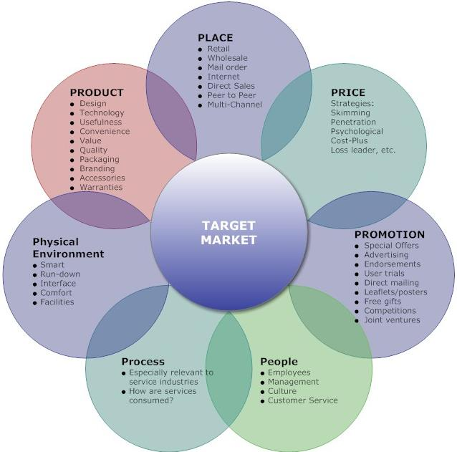
The flower
The 4Ps are classic elements of product marketing.
The 3 additional Ps are focused on services marketing.

Slide 16

An observation
The vast opportunity in tech reflects not only the far-reaching nature of the industry but also its sheer size: the market cap of the five biggest technology firms exceeds the combined GDP of several major economies. The tech industry is doing critical work, too, addressing climate change, improving health and education, advancing AI, and more. The impact of this work comes in part from the insights, skills, and leadership of women in tech.
When it comes to advancing women’s role in technology, however, there’s work to be done:
Read « Women in Tech » on bcg.com, part of « Proving the business value of inclusion «

Slide 17
Agenda for this S4
An interesting question
What do you remember of last time?
Positioning exercise
Preparation work for today
Input
Work for next time

Slide 18
Positioning
Positioning refers to the place that a brand occupies in the minds of the customers and how it is distinguished from the products of the competitors.
In order to position products or brands, companies may emphasise the distinguishing features of their brand (what it is, what it does and how, etc.) or they may try to create a suitable image (inexpensive or premium, utilitarian or luxurious, entry-level or high-end, etc.) through the marketing mix.
Once a brand has achieved a strong position, it can become difficult to reposition it.

Slide 19
Positioning : a method
Define a focus: what products / services do you want to position?
Define competitors’ products / services that can be compared.
Define product features and choose two that seem the most central ones of the offering.
Draw up the picture.
Do the same steps 2 – 4 for the brand.

Slide 20

Activity – in teams
Please develop two diferent marketing positionings for a hotel chain such as motel-one : one based on product features and the other based on image.
10’

Slide 21
Agenda for this S4
An interesting question
What do you remember of last time?
Positioning exercise
Preparation work for today
Input
Work for next time

Slide 22
Work for today
Individual work:
Read « Customer Relationship Management, 50minutes.com. (VLC, type in « customer relationship management », scroll to « scholarvox » and click on the title). 44 pages.
Teamwork
Formulate comments and questions. Each team mails me their list of comments & questions by Monday 6th March 6pm latest.

Slide 23
A few questions
What’s the use of CRM ?
What is attrition and why is it important to counter ?
What is front office vs back office ? Is CRM part of back- or front office? What is multichannel marketing ? One-on-one marketing ?
What are some customer key data the book mentions ?
What are the four stages of implementing a CRM ?
Who are the main suppliers of CRM software ?
How does CRM relate to ERP ?
What are some examples of B2B segmentation criteria ?
Cite some advantages of using CRM software.

Slide 24
Elements of answers
CRM is used in businesses and aims to optimise customer service, develop the sales force and provide statistical and customer monitoring tools for the pur-pose of marketing and data management. CRM drives the segmentation process, prospecting, creating customer loyalty, analysing customers, and so on.
The loss of customers over a given period. Also called churn. The opposite of retention. Context is the “customer lifetime value”.
The use of several means of communication between the company and the client, such as direct sales, phone, internet (social media, email, chat programmes, the company website, contact forms etc).
A type of marketing which contrasts with mass marketing in that it tries to communicate with each client separately to offer them a personalised service.

Slide 25
Elements of answers
Response rate + conversion + retention + satisfaction + complaints + ROI + acquisition cost + NPV.
A. Optimisation of data (cleaning) B. Choice of technology (function of size and staff) C. Process design and D. Training and coaching of people.
Last year Salesforce led with a 31.3% market share riding on a 12.6% jump in CRM revenues. Adobe was #2, followed by Oracle, SAP and Microsoft.
Firmographics + By tier (of potential value to your business) + By need + By sophistication level + By key accounts + By organisation type + By decision-makers and so forth. PS “If you’re not thinking segments, you’re not thinking” (Levitt).
Centralisation of client data + Optimisation of customer lifecycle + Enabling personalised offering.

Slide 26
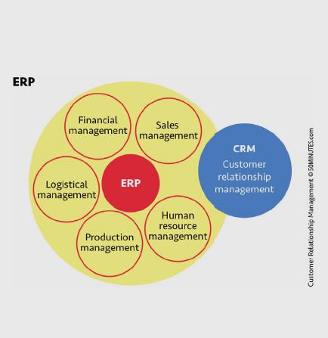
Q7

Slide 27
A few good reading materials
20 CRM Use Cases for Business Growth in 2023 | Netsuite
Customer Experience Explained - Strategy, Tips & Metrics | Netsuite
What Is Customer Retention - Importance, Metrics & Strategies | NetSuite
Don’t be deluded by the exaggerated claims made for AI | Financial Times
What is CRM | NetSuite
Why CRM and automation platforms go hand in hand | ClickZ
E-commerce Accelerator | Nielsen
Becoming indispensable: moving past e-commerce to neXT commerce | McKinsey Quarterly

Slide 28
Reminder - grading
Two grades will be attributed : a « continuous evalation » counting for 40% of your final grade and a « final exam » counting for 60% of your final grade.
The continuous evaluation grade will be based on a team presentation during session 5 of 22nd March. You will be asked to develop a case study.
The final exam will be a report, consisting of two parts: a collective 2,500 – 3,000 words in Word, summing up the case that has been presented in Session 5 + two open questions to be answered by individual team members. Text of open questions will be provided at session 5. The report will be submitted by end of March latest.

Slide 29
Content of presentation (and report)
An overview of external transitions impacting the business (S1).
A canvas (S2)
The customer journey (S3)
A flower analysis (S3)
Recommendations (in some detail) to Hoka management on the subject of implementing a CRM system in the business. Assume start from scratch.

Slide 30
Presentation of the case session 5
Logistics:
Duration: 20’ max.
Do not read from PCs. Eye contact with audience.
All students participate.
Powerpoint support.
Expected are analyses and learnings.

Slide 31

Feedback ?
Your reaction after this session 4 :
“WWW” – What Worked Well
“EBI” – Even Better If

